Slide 1


Candidate Selection Prediction

Slide 2

Problem Statement and Expectation
Problem : You are a data scientist of a big MNC who usually hires more than 10k candidates every year. To complete the task they conduct more than 1 lakhs interviews every year.
Expectation : Using data analysis, we want to predict who gets hired after an interview to make hiring decisions better and faster.

Slide 3

Data Facts and Preprocessing
Data Gathering
Data Cleaning
Data includes important details like :-
The dataset contains a small number
of missing values.
candidate id
For categorical columns, I used the mode, and for numerical columns, I employed the mean. Additionally, there were no duplicated values present.
interview duration
late joining
candidate profile

Slide 4

Exploratory Data Analysis (EDA)
The dataset contains With 5800 rows and 26 column including
with target variable.
So with the Describe Function we saw that Interview
duration
mean : 37 minutes
standard deviation : 13 minutes
shortest interview : 15 minutes
longest Interview : 60 minutes
This summary provides an overview of the numerical
characteristics and range of values present in the
dataset columns.

Slide 5
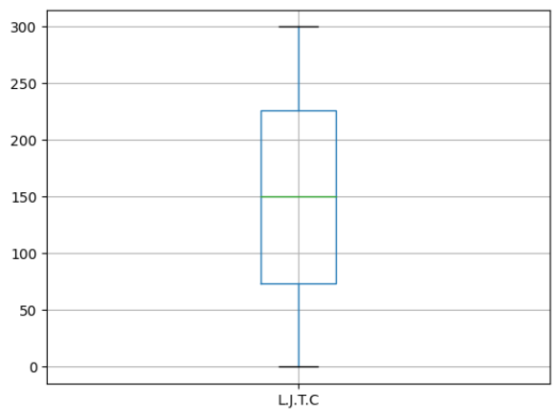
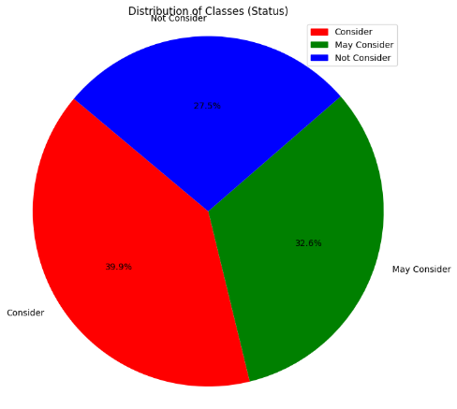
Boxplot Pie chart
I carefully examined all 26 columns of the data and didn't find any outliers in it. The classes of our target variables also have equal distribution, similar sizes, which is beneficial for our analysis.

Slide 6
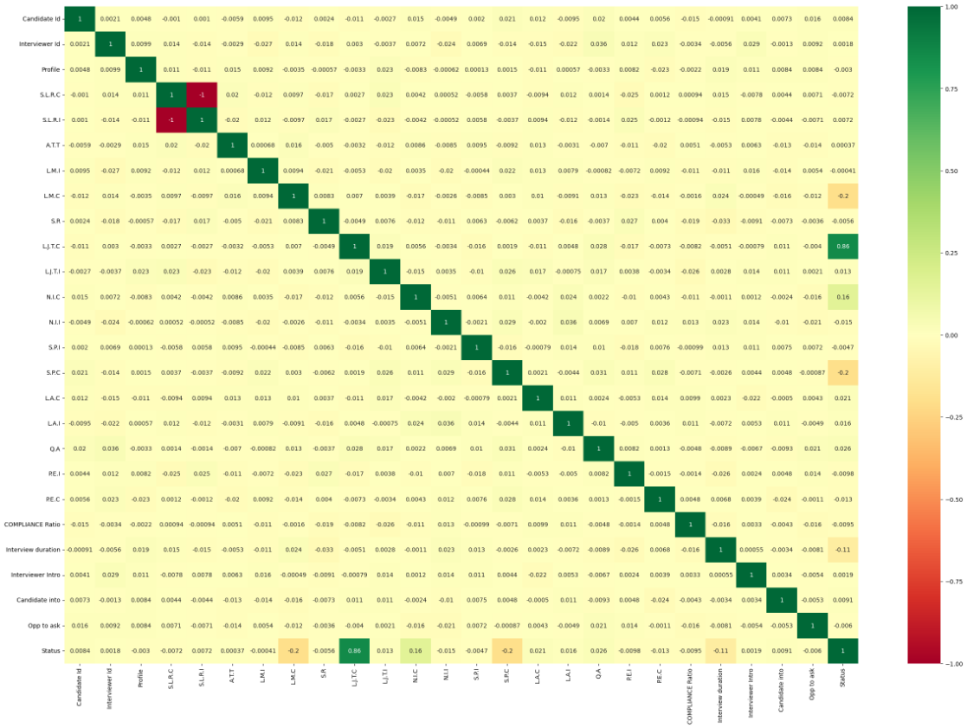
Heatmap Correlation
I can see that five columns in my data really matter for the target column status.

Slide 7

Feature Engineering
1
Feature Transformation
I applied the Standard Scaler technique to transform the data.
2
Feature Selection
The columns ( L.M.C, L.J.T.C , N.I.C, S.P.C, L.A.C, Interview duration and Status ) based on a heatmap correlation analysis.
This approach has helped me for accurate modeling and insightful decision-making in the context of the interview process.

Slide 8


Model Selection and Hyperparameter Tuning
I split the data into training and testing sets with an 80 : 20 ratio.
I evaluate different machine learning algorithms like Logistic regression, Decision Tree, Random Forest, K-Nearest Neighbors and SVC.
Hyperparameter tuning — grid search cv

Slide 9
Accuracy on Training and Test Data
Model
Training
Test
Logistic regression
0.9968
0.7091
Decision Tree
0.9293
0.6483
Random Forest,
0.9241
0.6708
K-Nearest Neigxhbors
0.9422
0.6475
SVC
0.9974
0.7075
Logistic regression and SVC is performing better almost 71% accuracy.

Slide 10
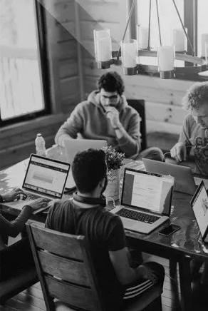
Challenging Part :
The most challenging part of the project is to pick the
right features for my model.
Tuning logistic regression takes a lot of time to find the
exact value for the best parameter.
But I haven't reached the best accuracy yet. Maybe I can do
better with deep learning or other methods, but I’m not
familiar with that, because also of less domain knowledge.

Slide 11

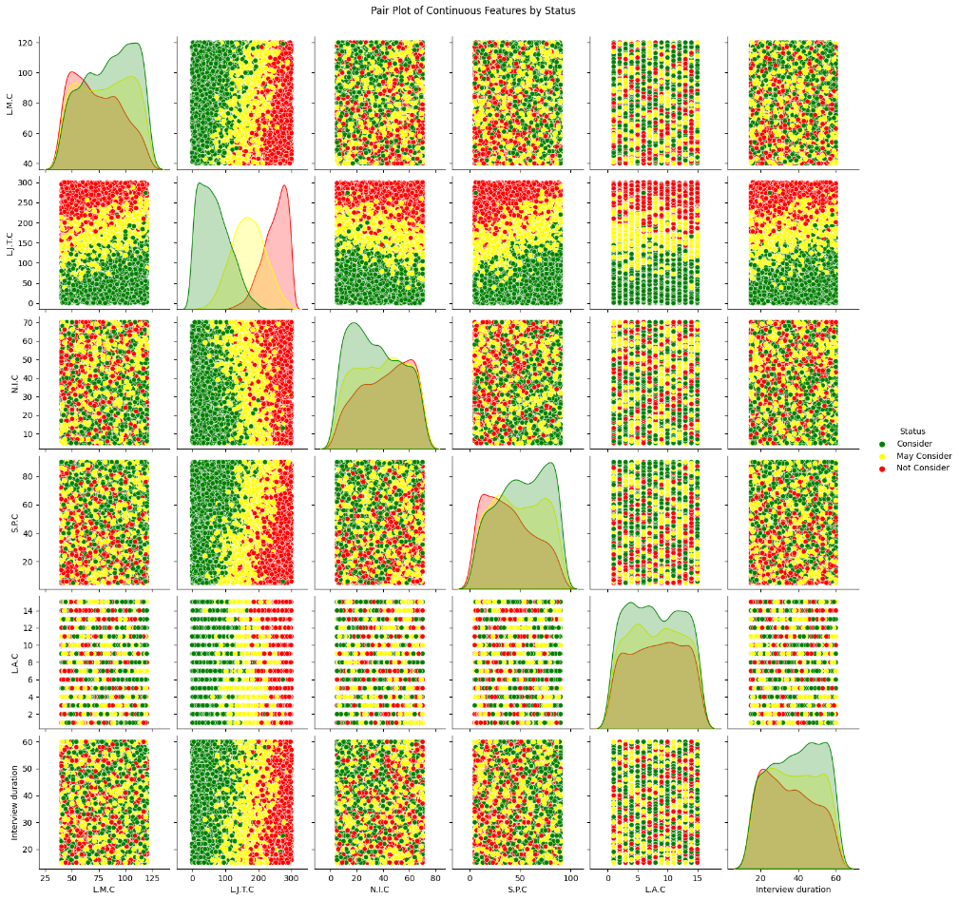
Pairplot - Visualizing Relationships

Slide 12
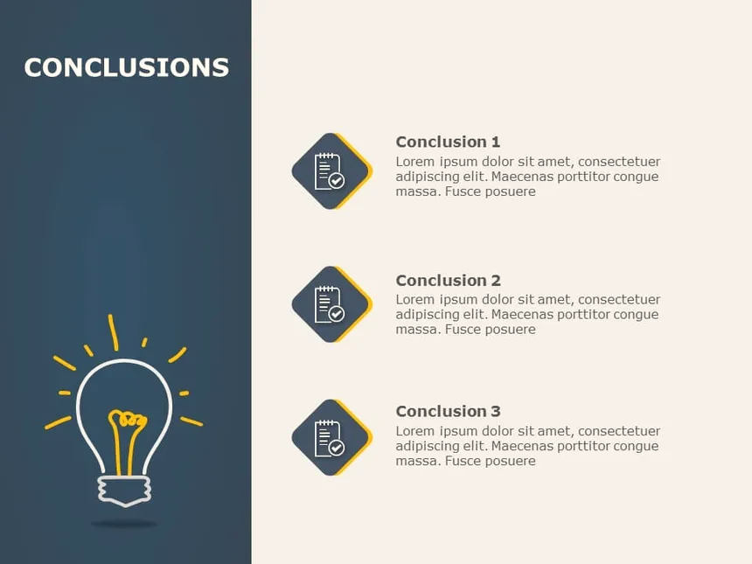
Conclusions
We achieved a 70.91% accuracy by removing unnecessary features and cleverly handling missing data. Logistic Regression performed well in predicting Status.
I found that (Interview Duration) How long a candidate takes in the interview affects the model's performance.
Late joining candidates (LJTC) also impact the likelihood of not getting selected.
Longest amount of time spoken (LMC) column is also impacting for selection, as speaking for a long time might lead to their selection.
This method helps avoid biases, saves time for recruiters, and ensures fair hiring.

Slide 13

This Photo by Unknown Author is licensed under CC BY

